Slide 1
Danfoss-Mini TT Shaft Bearing Press
Team 512
October 24, 2023

Slide 2





Team Introductions
Clark Cooley
Systems Engineer
Cassie Bentley
Fluids Engineer
Colby Gullo
Safety Engineer
Brent Mynard
CAD Engineer

Slide 3



Sponsor and Advisor
Engineering Mentor
William Bilbow
Point of Contact
& Sponsor
Engineering Mentor
Kevin Lohman
Sponsor
Academic Advisor
Shayne McConomy
Professor

Slide 4

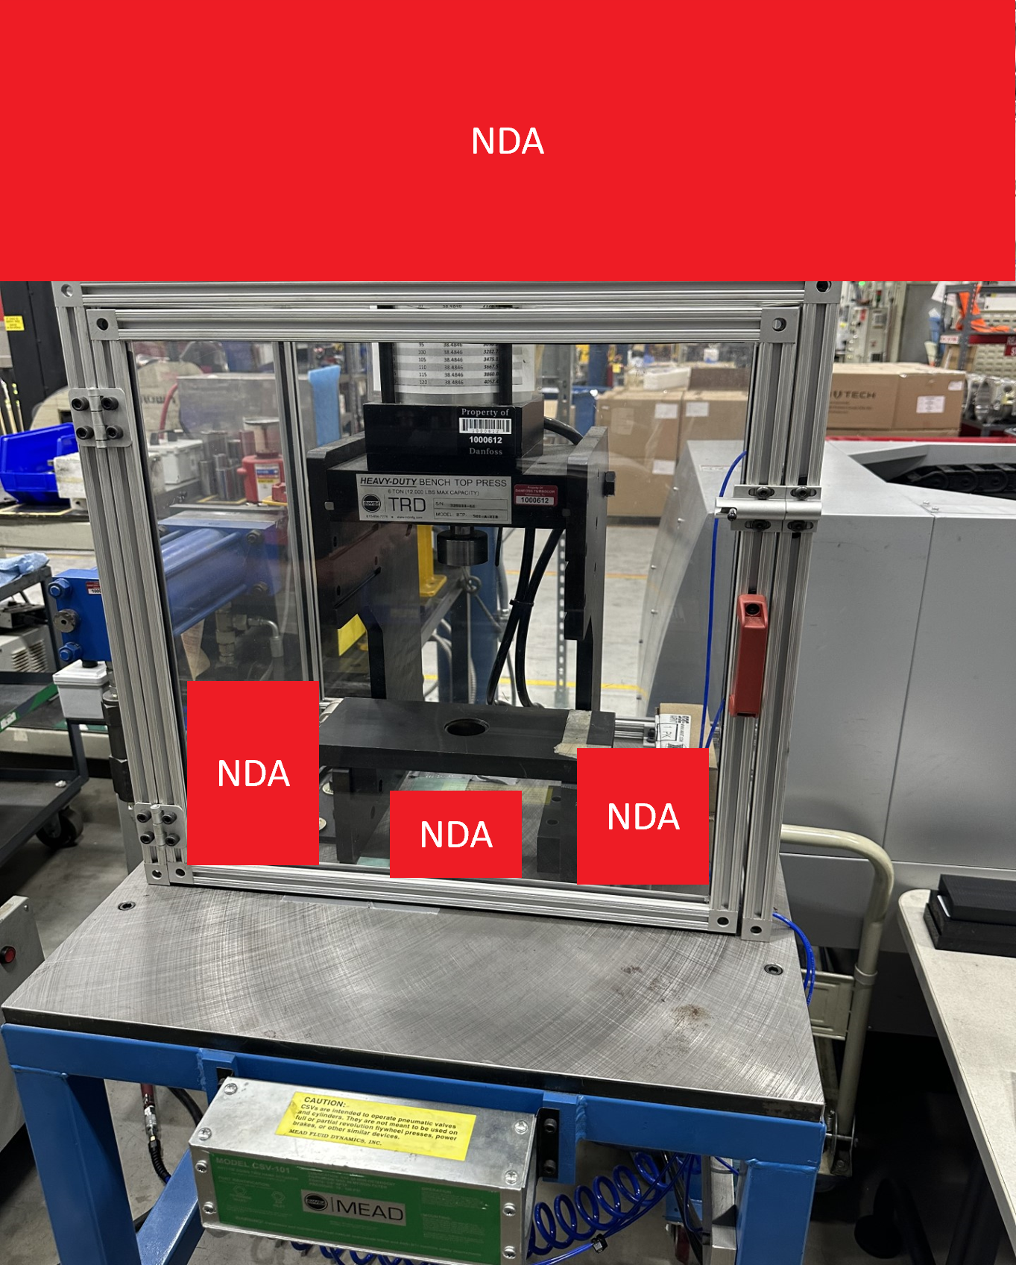
Objective
The objective of this project is to redesign the existing bearing press to press bearings of various sizes onto studs while ensuring ease of manipulation and user safety.

Slide 5
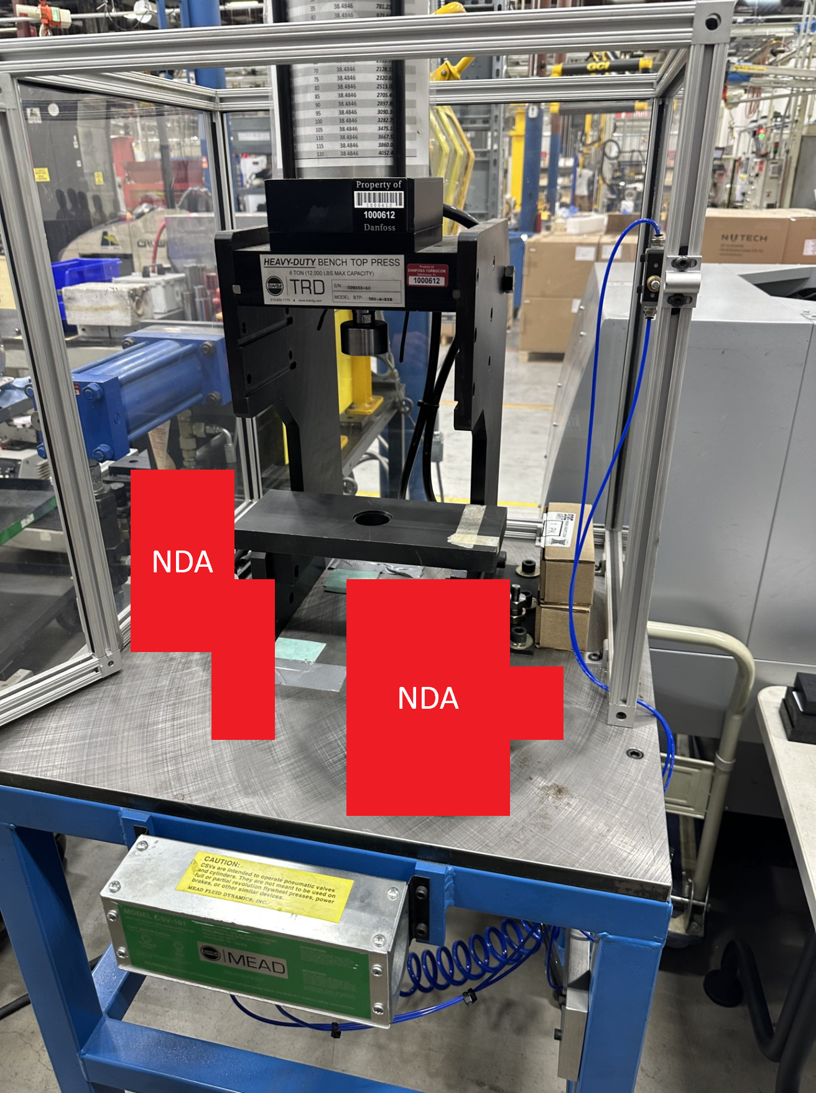
Project Background
  Original press created in 2020
  Press applies 6 tons of pressure
  Bearings are heated to 600 degrees and pressed on to shaft stubs
  Press has two button engagement
  Base plate height is fixed

Slide 6
Project Scope
Clark Cooley

Slide 7





Key Goals
Modular Baseplate
Press Bearing on shaft stud
Ensure Safety of user
Allow user ease of usage
Optimize Cost

Slide 8



Markets
Primary Market
Secondary Market

Slide 9
Assumptions
Access to the existing Mini-TT shaft bearing press and key components
Access to the machine shop at Danfoss or FAMU-FSU College of Engineering.
Budget of $10,000
Compressed air is used to create pressure
Bearings are heated to 600°F
Press will be stationary

Slide 10

Stake-Holders

Slide 11
Customer Needs
Colby Gullo

Slide 12
Customer Needs
Able to apply 6 tons of pressure to mend a bearing to a shaft stud
Modular baseplate to adjust working area of press
Interlock door switch with a safety relay
Pneumatic adjustable hold timer
Ensure the safety of the user
Apply ventilation to the press to cool hot metals

Slide 13
Current Shaft Press
Currently works but is not in production at Danfoss.
Pneumatic pressure system to make machine simpler.
Can apply 6 tons of pressure when activated.
Small and can handle only one type of bearing.
Little protection for any users.
Requires constant buttons activation for the press to operate.

Slide 14
Functional Decomposition
Colby Gullo

Slide 15
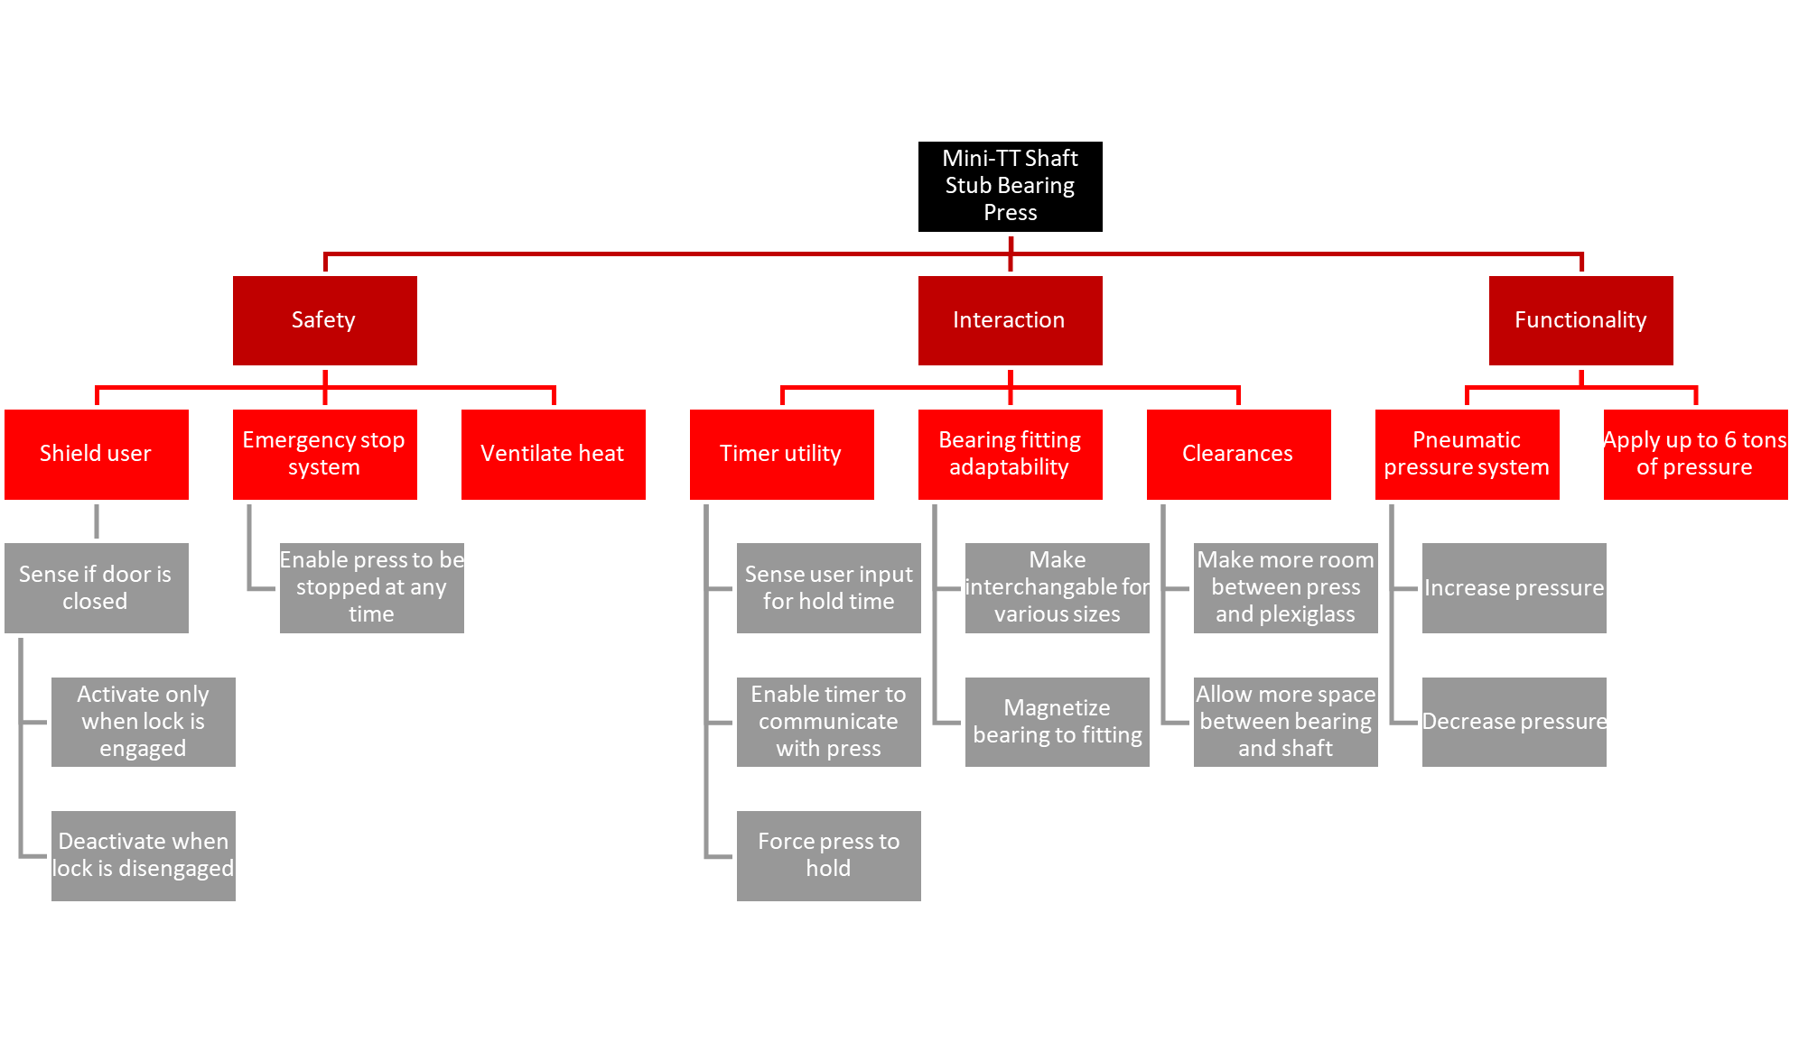
Functional Decomposition Hierarchy Chart
Colby Gullo
15

Slide 16
Functional Decomposition: Safety
The first branch (safety) is divided into three separate areas:
Shield User:
When the user interacts with the system, they must have protection in case of emergencies.
The emergency stop system:
This allows the user to stop the press immediately if something has gone wrong during standard operation.
The ventilation:
Allows for heat to escape from the system since bearings will be heated to nearly 600℉ when in operation, preventing heat buildup in the system.
Colby Gullo
16

Slide 17
Functional Decomposition: Interaction
The second branch (Interaction) is divided into three separate areas:
Timer functionality:
Implementing a sensor capable of holding down the press for a specific duration (x amount of time).
Bearing fitting adaptability:
New bearing press needed to address both emerging and existing constraints
Clearances:
Increase the clearance between the press and the plexiglass.
Colby Gullo
Colby Gullo
17

Slide 18
Functional Decomposition: Functionality
The third branch (functionality) is only split into two systems
Pneumatic Pressure System:
The user can communicate to the system about how much pressure to apply and when to increase or decrease the pressure
Apply up to 6 tons of pressure:
Pressure when the device is operating will apply 6 tons.
Colby Gullo
18

Slide 19

Future Work
Targets and Metrics
Concept Generation & Selection
Meet With Sponsors
Transport Existing Press
Colby Gullo
19

Slide 20
Thank you

Slide 21
Backup Slides

Slide 22
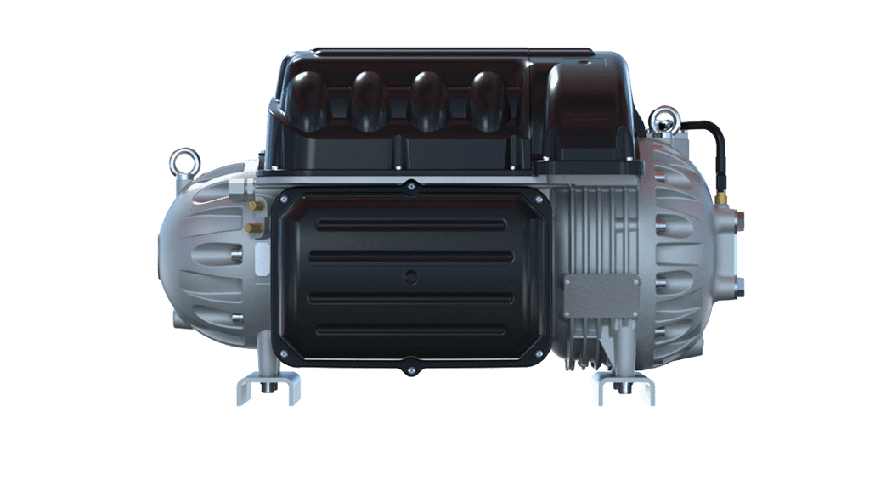
Danfoss Turbocor® TT series
Oil free compressors using HFC134a refrigerant

Slide 23
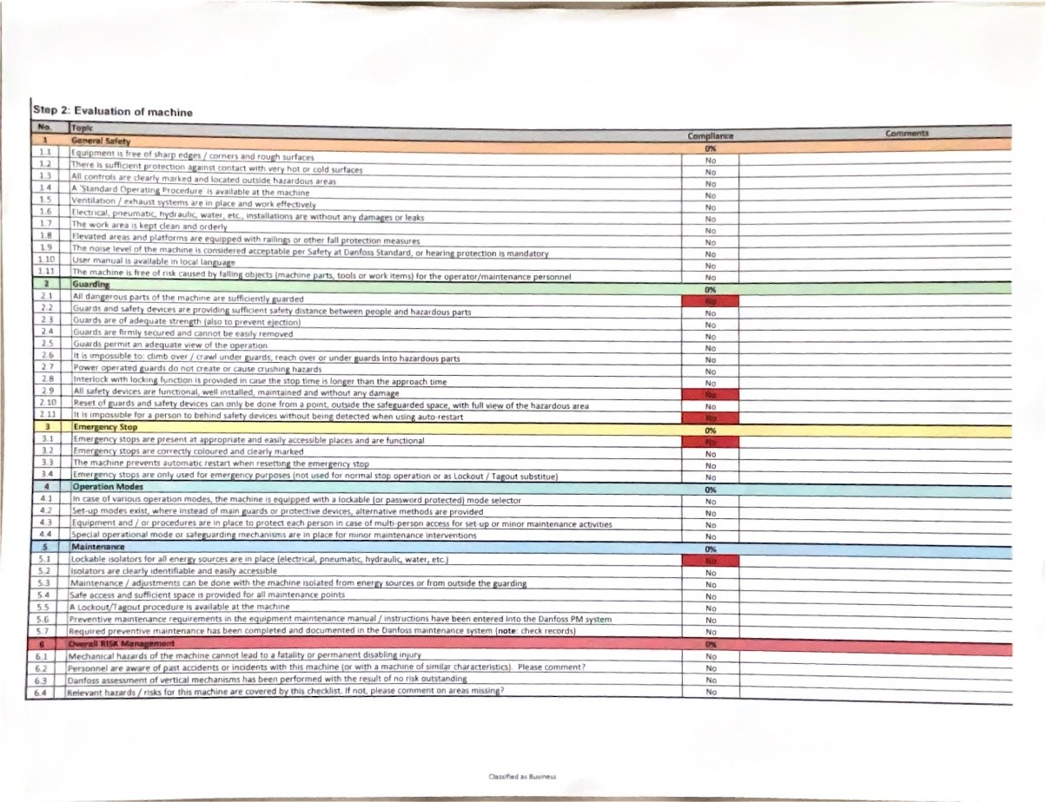
Machine Evaluation Sheet

Slide 24
Cross Reference Table
 | Safety | Interaction | Functionality | Total
Shield user | X |  |  | 1
Sense if door is closed | X |  |  | 1
Ventilate heat | X |  | X | 2
Sense user input |  | X |  | 1
Enable timer to communicate with press |  | X | X | 2
Force press to hold | X | X |  | 2
Make interchangeable for various sizes |  | X | X | 2
Magnetize bearing to fitting |  | X |  | 1
Make more room between press and plexiglass | X | X |  | 2
Allow more space between bearing and shaft |  | X |  | 1
Increase/Decrease pressure |  | X | X | 2
Apply up to 6 tons of pressure |  |  | X | 1
Total | 5 | 8 | 5

Slide 25
This is 10-point
This is 15–point Times
This is 20–point
This is 25–point
This is 30–point
This is 35–point
This is 40–point
This is 50–point
This is 60–point
This is 72–point
Notes:
Use at least 20-point font in Room A105, B134, and B136
Use at least 25-point font in Room B135

Slide 26
College of Engineering Color Palette
1 2 3 4
Pantone: PMS 195 C
RGB: 120, 47, 64
Hex: #782F40
CMYK:19, 90, 50, 55
1 2 3 4
Pantone: Black C
RGB: 0, 0, 0
Hex: #000000
CMYK:0, 0, 0, 100
Garnet
Black
1 2 3 4
RGB: 238, 118, 36
Hex: #EE7624
CMYK:2, 66, 99, 0
1 2 3 4
Pantone: PMS 000C
RGB: 255, 255, 255
Hex: #FFFFFF
CMYK: 0, 0, 0, 0
Fang
Orange
White
Notes:
Avoid 75% Black in B135

Slide 27
Accent Color Palette
1 2 3 4
RGB: 0, 59, 111
Hex: #003B6F
CMYK:
1 2 3 4
RGB: 0, 59, 111
Hex: #003B6F
CMYK:
1 2 3 4
RGB: 251, 236, 93
Hex: #FBEC5D
CMYK:
1 2 3 4
RGB: 219, 215, 210
Hex: #DBD7D2
CMYK:
1 2 3 4
RGB: 251, 236, 93
Hex: #FBEC5D
CMYK:
1 2 3 4
RGB: 219, 215, 210
Hex: #DBD7D2
CMYK:
Tardis Blue
Tardis Blue
Corn
Timberwolf
Corn
Timberwolf
1 2 3 4
RGB: 206, 0, 88
Hex: #CE0058
CMYK: 0, 100, 43, 12
1 2 3 4
RGB: 206, 0, 88
Hex: #CE0058
CMYK: 0, 100, 43, 12
1 2 3 4
RGB: 104, 40, 96
Hex: #682860
CMYK:
1 2 3 4
RGB: 220, 220, 220
Hex: #DCDCDC
CMYK:
Rubine Red
Rubine Red
Imperial
Gainsboro
1 2 3 4
RGB: 72, 146, 155
Hex: #48929b
CMYK:
1 2 3 4
RGB: 64, 224, 208
Hex: #40E0D0
CMYK:
1 2 3 4
RGB: 255, 139, 0
Hex: #FF8B00
CMYK:
Asagi-iro
Turquoise
American Orange
Notes:
Remove American orange add hyperlink grey
Make corn the last for b135
All work in 134 imperial move later
Tardis doesn’t work in b136

Slide 28
F7AB19
D67F15
EE7624
D64615
F73119
Analogous
https://color.adobe.com/create/color-wheel
6E3610
F0A16C
EE7624
6E4931
BASB1C
Monochromatic
A14508
4BED3B
EE7624
250CED
2010A1
Triad
A1470C
FF8C40
EE7624
0098A1
24E2ED
Complementary
28A164
2FED8D
EE7624
0848A1
1871ED
Split Complementary
EDAC2F
3BED93
EE7624
0C6AED
ED2F18
Double Split Complementary
ED660C
C7ED3B
EE7624
0CE1ED
A418ED
Square
BA7E09
87724A
EE7624
60EFCF
09BA61
Compound
AD551A
6E3610
EE7624
FA7625
D46820
Shades
Notes:
These are the variants that work well with Fang Orange. The bolded items show well on the projectors.

Slide 29
85412D
8F3831
782f40
8F3176
792D85
Analogous
https://color.adobe.com/create/color-wheel
C44D69
8E626D
782F40
C48796
451B25
Monochromatic
C43959
78743B
782F40
236178
43A2C4
Triad
C43959
C46078
782F40
25C43D
2F783A
Complementary
93C460
577835
782F40
39C49D
297861
Split Complementary
784435
5A783B
782F40
237860
6E2978
Double Split Complementary
782337
78683b
782F40
237830
293978
Square
AB4D32
DEBAAF
782F40
5D8555
70AB32
Compound
38161E
C44D69
782F40
853447
5E2532
Shades

Slide 30
A105
A105
B135 Stage Left
B135 Stage Right
B136
B134, A105
B135

